Slide 1

Loan analysis
delivered By
Karnan K
karnank919@gmail.com

Slide 2

01 OBJECTIVES
03 Insights
04 CONCLUSIONS
02 Analysis

Slide 3
INTRODUCTION
The dashboard presents customer data with attributes like ID, Age, Income, ZIP Code, and Family size. It also includes financial metrics such as CCAvg, Mortgage, and product engagement indicators like Personal Loan, CD Account, and Online usage. This data helps analyze customer profiles and their interaction with financial services.

Slide 4
01. Age group
In this analysis, we observe that customers aged 46 and above are more likely to secure personal loans, indicating a higher loan approval rate within this age group.
Conversely, individuals in the 23 to 30 age range show the lowest rate of personal loan acquisition, suggesting less engagement with loans among younger customers.

Slide 5
02. AREA wise INCOME
This chart helps identify areas with higher income levels. Based on the dataset, we observe that the ZIP code 91326 has the highest average income, indicating a concentration of wealth in that area.

Slide 6
03. Income v/s loan
The analysis reveals that individuals with an average salary in the $94K to $136K and $137K to $179K income brackets are more likely to take out personal loans, showing a higher loan engagement among these earning groups.

Slide 7
04. Income and loan by experiences
Through this analysis, we can determine which experience levels are associated with higher income and their corresponding loan counts. It is evident that individuals with more experience tend to have higher earnings, demonstrating a greater capacity to secure personal loans based on their income level. This suggests that experienced professionals are more financially stable and capable of handling loans.

Slide 8
This analysis highlights the relationship between CCAvg (average credit card spending) and loan amounts. It shows that individuals with higher CCAvg tend to secure larger loan amounts, suggesting that increased spending behavior may positively influence loan approvals and creditworthiness.
05. Cc avg v/s personal loan

Slide 9
06.Credit card users
Age Group Trends: Individuals over 46 years old show a higher adoption rate of credit cards, indicating strong preferences for credit products in this demographic.
23-30 Age Group Analysis: This group has an equal distribution of credit card users and non-users, suggesting potential for growth and targeted marketing efforts.
Targeted Marketing Opportunities: By identifying non-users and analyzing their income levels, we can effectively target higher-income individuals who have not yet adopted credit card usage.

Slide 10
07.Mortgages vs personal loan in top 10 area
By analyzing area-wise data on mortgages and personal loans, we can identify regions with a higher demand for these financial products. This insight allows us to determine which areas are more likely to require loans, enabling us to tailor our offerings and promotional strategies accordingly. By focusing on these high-demand regions, we can enhance our marketing efforts and potentially increase loan uptake.

Slide 11
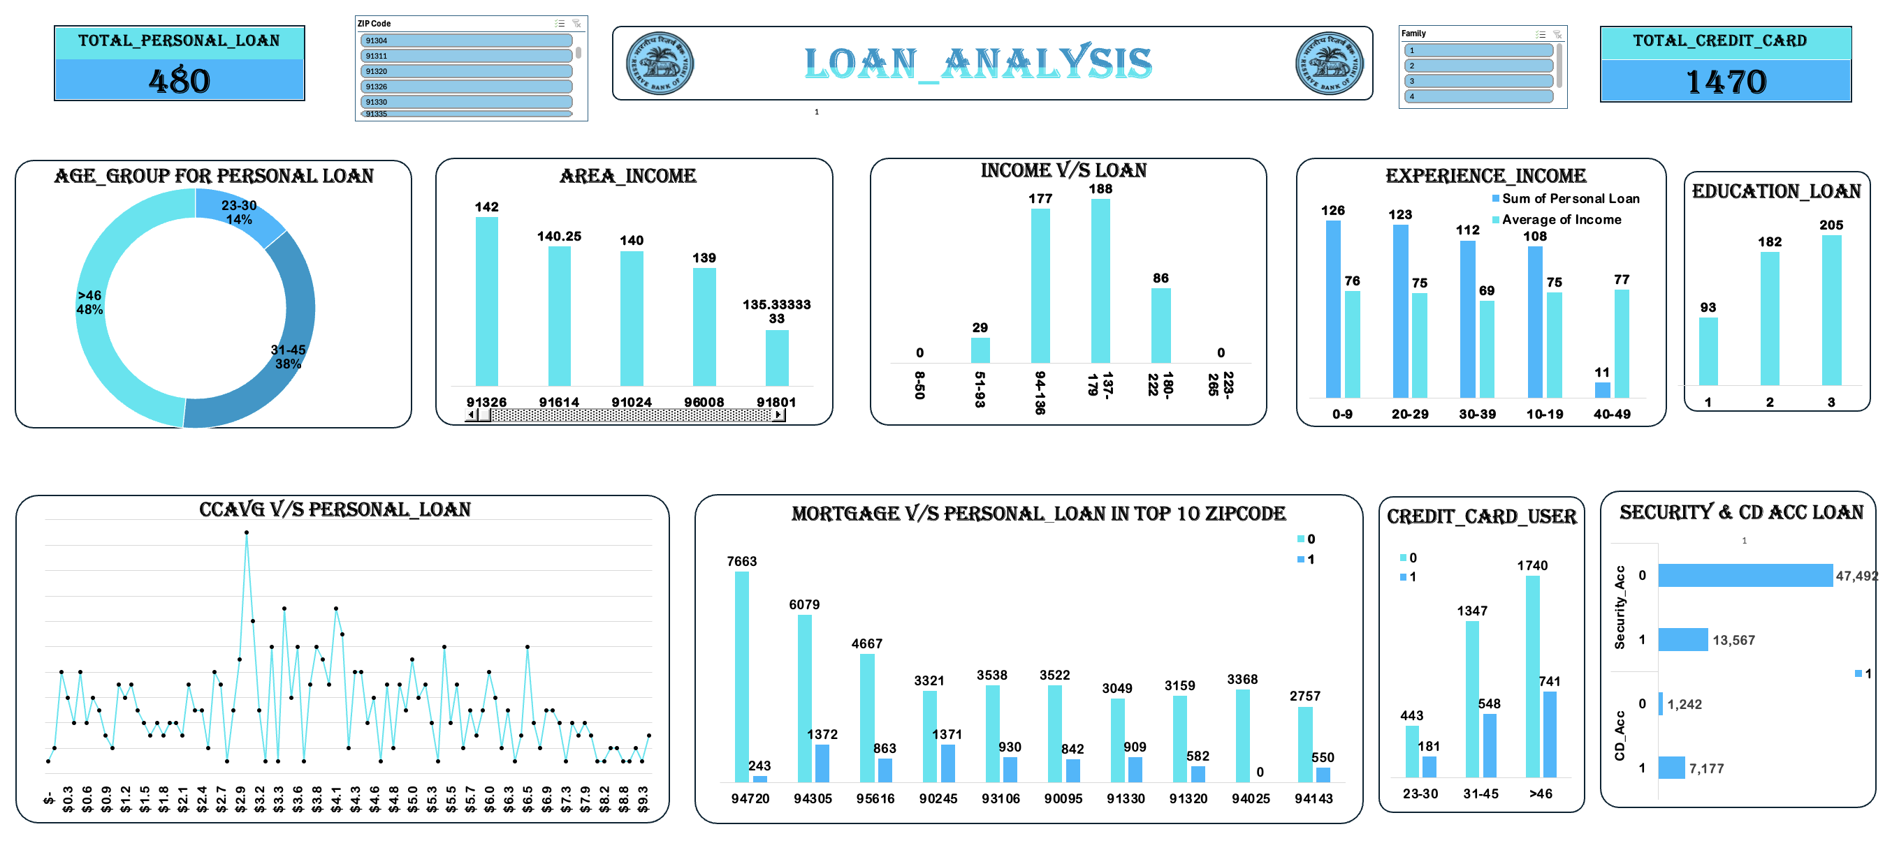

dashboard

Slide 12
recommendation
01
Targeting Loan Offerings for the 46+ Age Group
02
Expanding Loan Offerings in ZIP Code 90245
03
Opportunities for Credit Cards and Personal Loans in Higher Education
04
Supporting Financial Growth for Individuals with Securities Accounts
Our analysis reveals that individuals over 46 are securing more loans, presenting a key opportunity to focus on this demographic. By offering tailored loan products with attractive benefits, we can effectively meet their financial needs, enhance customer satisfaction, and drive increased loan uptake.
In ZIP code 90245, residents are taking both mortgages and personal loans, showing a high demand for financial products. By examining their income levels, we can customize our loan offerings to better meet their needs, which could lead to more loans and support community growth.
More people are taking education loans, particularly for higher studies, highlighting areas where students need financial support. By identifying these regions, we can offer credit cards along with personal loans to help improve students' financial stability. This approach ensures that students have the resources they need for their education.
People with securities accounts usually have better financial stability, making them good candidates for loans and mutual funds. By acknowledging this, we can offer them financial solutions that fit their investment needs, helping them grow their finances.

Slide 13
conclusion
In conclusion, our analysis highlights key opportunities in targeting specific demographics for financial products. Individuals over 46 and those in high-demand areas like ZIP code 90245 show strong potential for loan offerings. Additionally, supporting students with education loans and providing tailored solutions for securities account holders can enhance financial stability. By strategically focusing on these insights, we can foster growth and improve customer satisfaction across various segments.

Slide 14
THANKS
Does anyone have any questions?
karnank919@gmail.com
+91 7795375472
https://decodet.com/

